Slide 1

Rusterizer Masterclass Rendering Pipeline
Luca Quartesan – quartesan.l@buas.nl – 03-10/02/2021

Slide 2
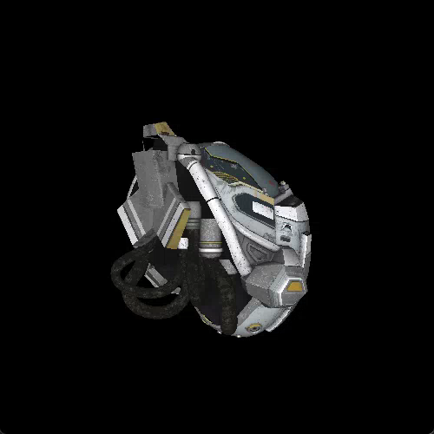
Agenda
Recap
Let’s compare with OpenGL
Powering up your Rusterizer

Slide 3
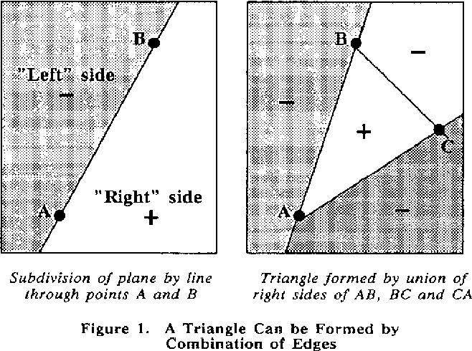
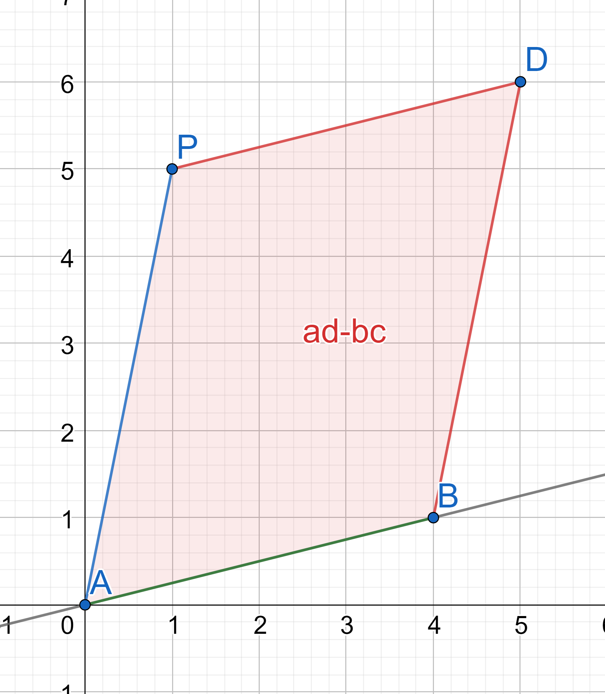
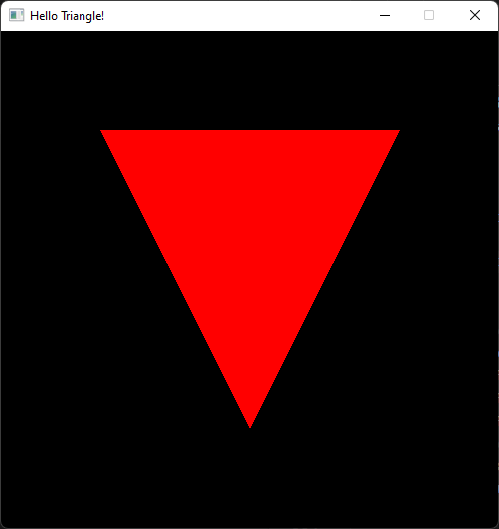
Recap 1
Edge function tells on which side of a line a point lies
Calculated using matrix determinant (cross product), which returns the signed area of the parallelogram
We compute the edge function for each edge
If all positive then the point is inside the triangle
Did you try with counter clockwise triangles?

Slide 4
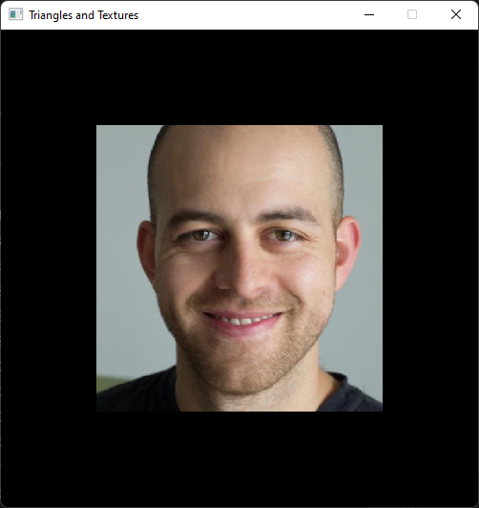
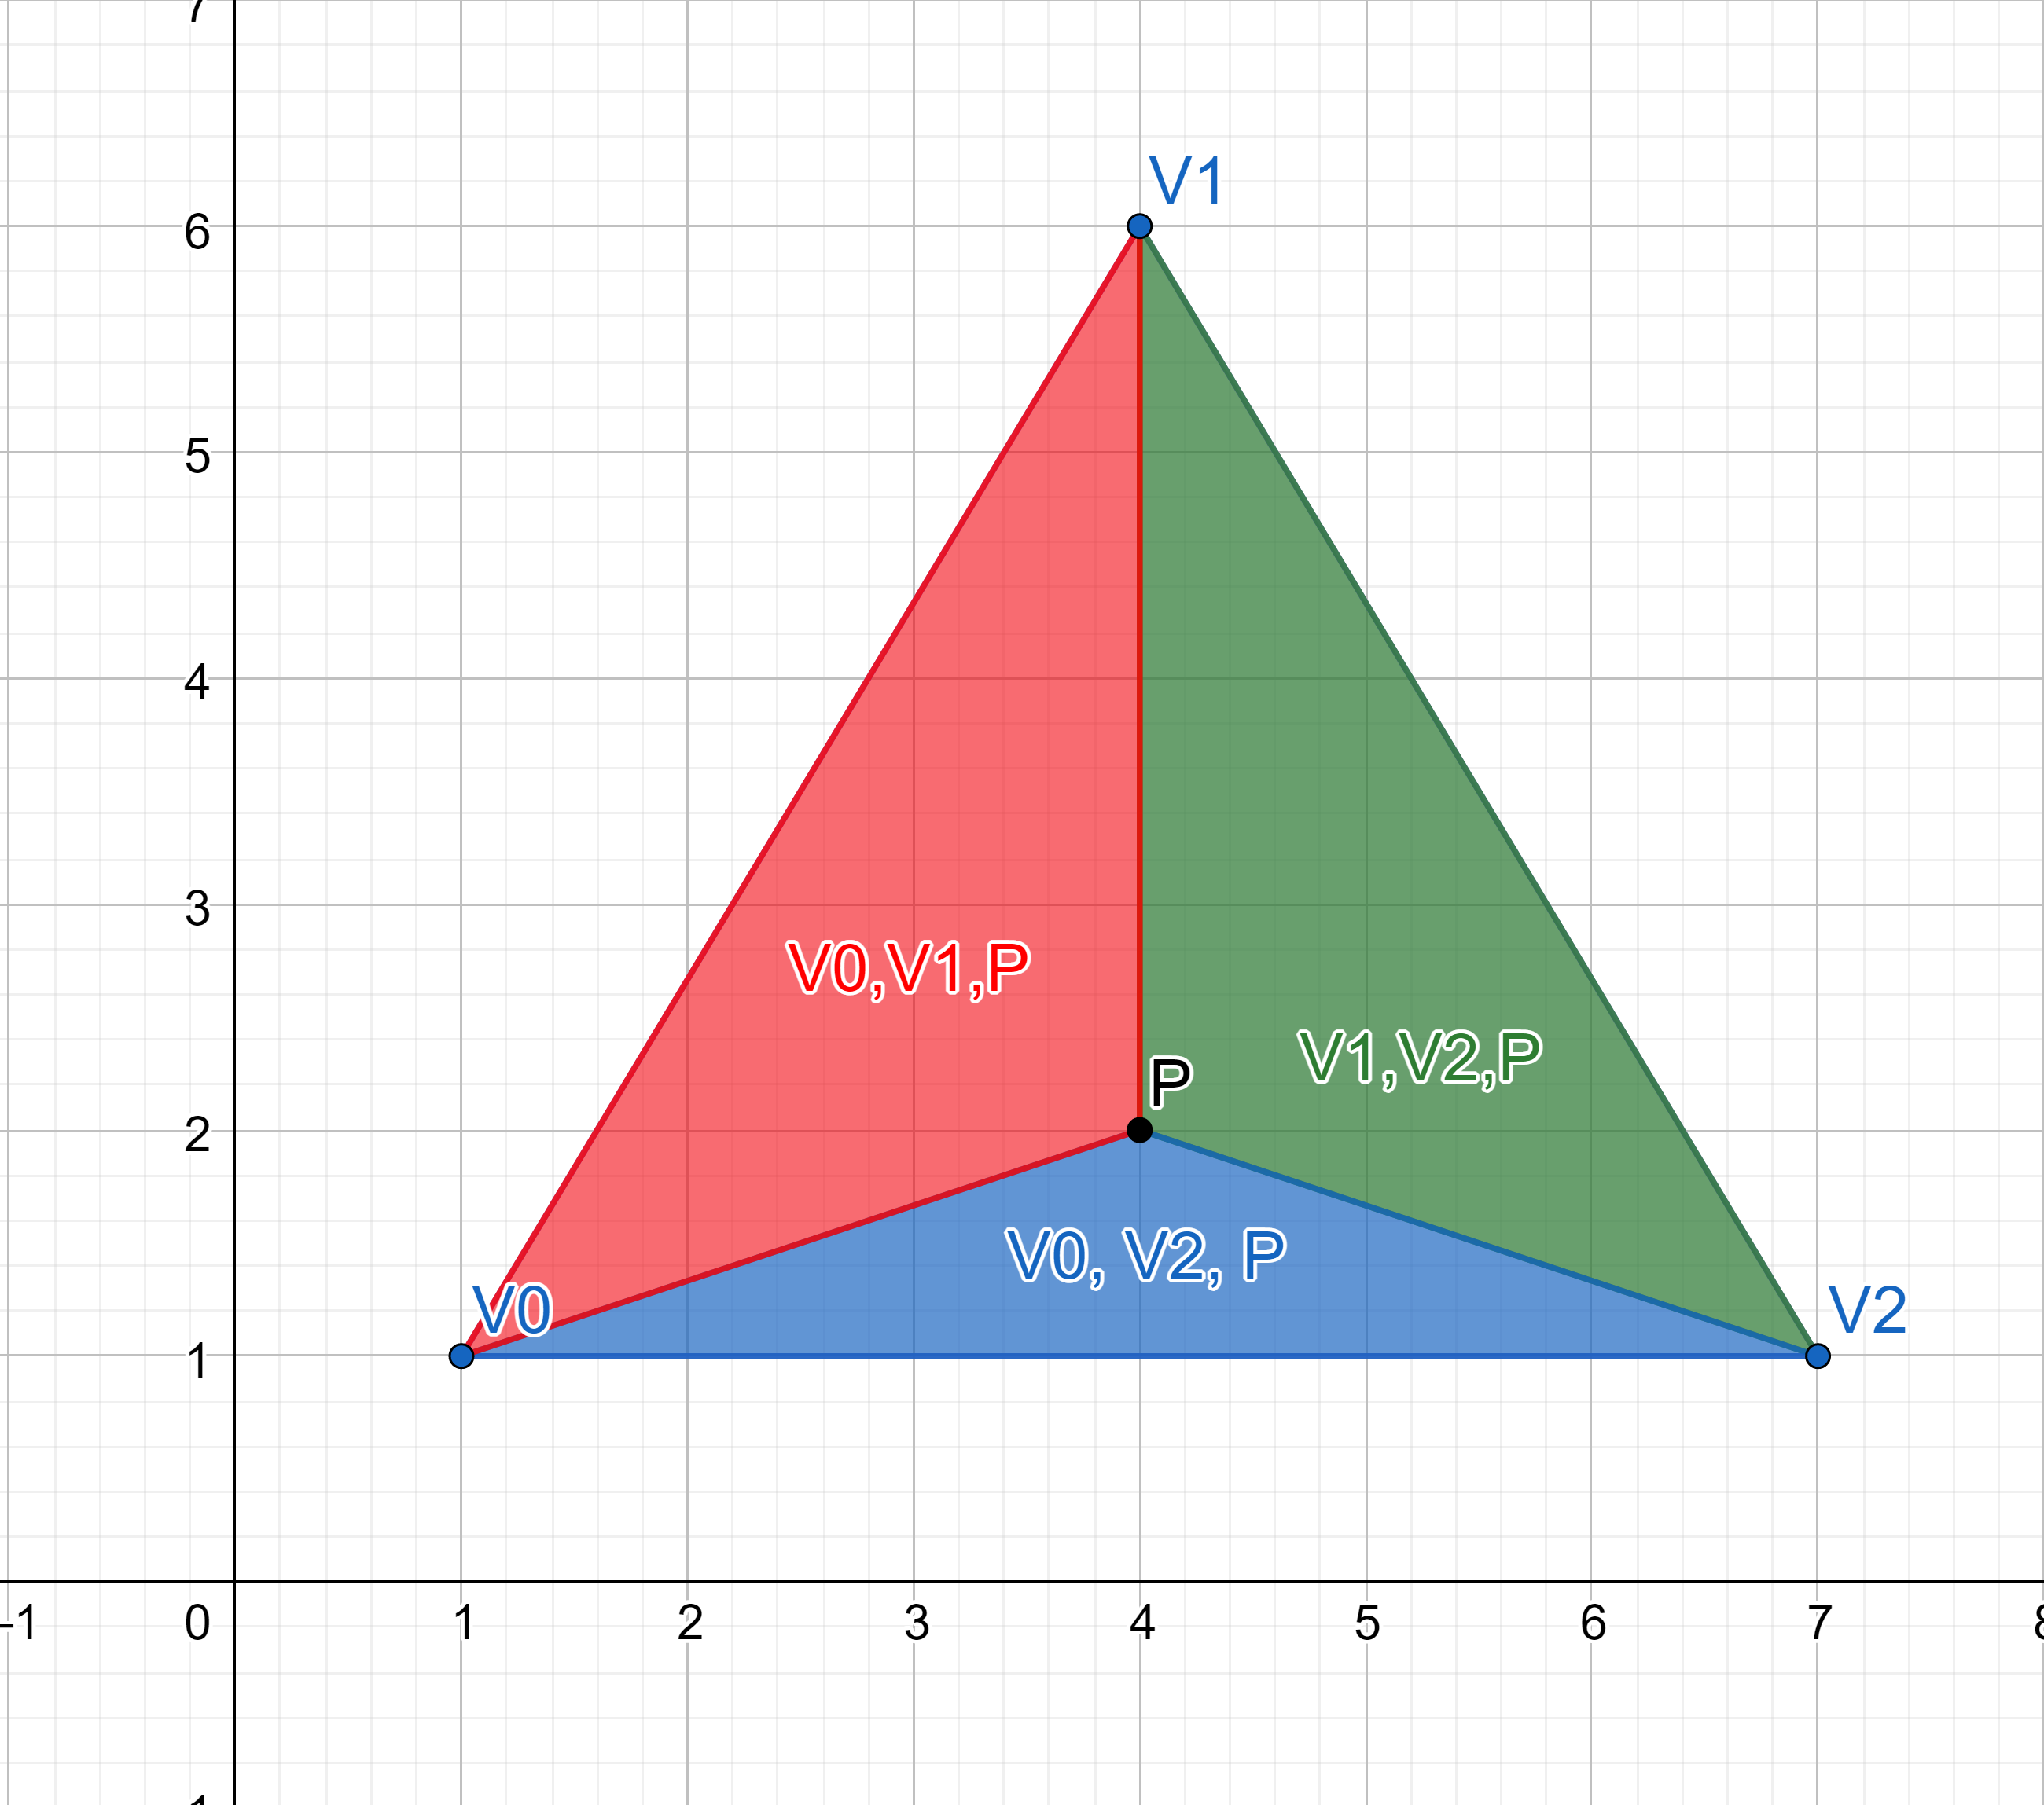
Recap 2
Vertex attributes describe position and other surface parameters
We can map textures to surfaces
When rasterizing a surface we interpolate the vertex attributes
We can do this with barycentric coordinates
Barycentric coordinates ⚖️ weights
how close we are to a vertex
how much a that vertex contributes

Slide 5
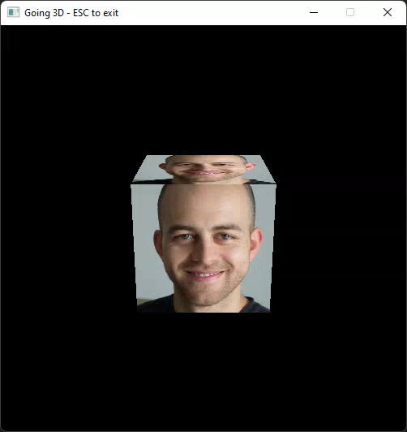
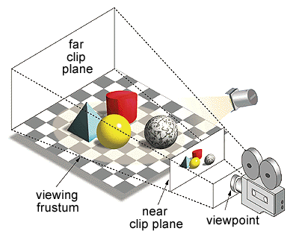
Recap 3
3D Transformations = Matrices * Vectors
Concatenating transformations
Model * View * Projection to transform from 3D to 2D
Perspective correction to interpolate while taking depth into account
https://gdbooks.gitbooks.io/3dcollisions/content/Chapter6/frustum.html

Slide 6
Recap 4
Clipping: fitting triangles in the view volume
Culling: discarding triangles based on the direction they are facing
Loading a model (GLTF)
Transforming and using Normals
Simple shading: Normal dot light direction

Slide 7
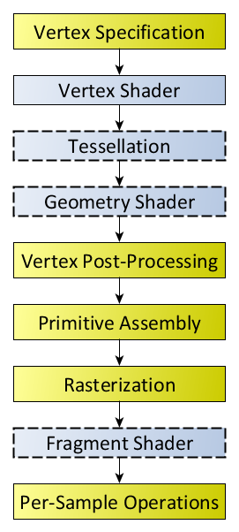
Open GL Rendering pipeline
Yellow boxes are fixed stages
Blue boxes are programmable stages of the pipeline
We can control what happens
https://www.khronos.org/opengl/wiki/Rendering_Pipeline_Overview

Slide 8
Open GL Rendering pipeline
Vertex specification:
Ordered list of vertices set up (VAO, VBO)
Vertex shader:
Define operations to apply on incoming vertices
If no tessellation and geometry expected to return the vertex after projection
Vertex * MVP happens here
https://www.khronos.org/opengl/wiki/Rendering_Pipeline_Overview

Slide 9
Open GL Rendering pipeline
Tessellation:
Primitives (e.g. Triangles) can be further split
Geometry shader
Process incoming primitive returning either zero or more output primitives
https://www.khronos.org/opengl/wiki/Rendering_Pipeline_Overview

Slide 10
Open GL Rendering pipeline
Vertex Post processing
Primitive assembly
Collect vertex data from previous stages into a sequence of primitives
Clipping
Primitives are clipped with view volume
Perspective divide
Divide vertex attributres by the clip space w
https://www.khronos.org/opengl/wiki/Rendering_Pipeline_Overview

Slide 11
Open GL Rendering pipeline
Clipping
We discard and split primitives that don’t lay completely inside the view volume
Face culling
Triangles are discarded based on the direction they are facing
https://www.khronos.org/opengl/wiki/Rendering_Pipeline_Overview

Slide 12
Open GL Rendering pipeline
Rasterization
Primitives rasterized in the order they were provided
Results in a sequence of fragments
Fragment: state used to compute the final pixel color. It describes screen space position and interpolated user defined data
https://www.khronos.org/opengl/wiki/Rendering_Pipeline_Overview

Slide 13
Open GL Rendering pipeline
Fragment Shader
Data for each fragment is processed and a color is returned
Per-sample operations
Pixel ownership
Scissor Test
Stencil Test
Depth Test
https://www.khronos.org/opengl/wiki/Rendering_Pipeline_Overview

Slide 14
Pipeline comparison
We managed to implement a form of most of the stages in the open GL rendering pipeline
Only tessellation and geometry shader were not addressed at all (for good reason)
👏
Now let’s have a look at how you can power up your rasterizer!

Slide 15
Thank you! 🦀
Many questions?

Slide 16
Resources
Rasterization: a Practical Implementation
Optimizing Software Occlusion Culling – index | The ryg blog
Texture Mapping & Polygon Rasterizing Tutorial (1/2) [C++20] – YouTube
3D Programming Fundamentals [Introduction] Tutorial 0 – YouTube
Rasterizer Algorithm Explanation – YouTube

